Slide 1
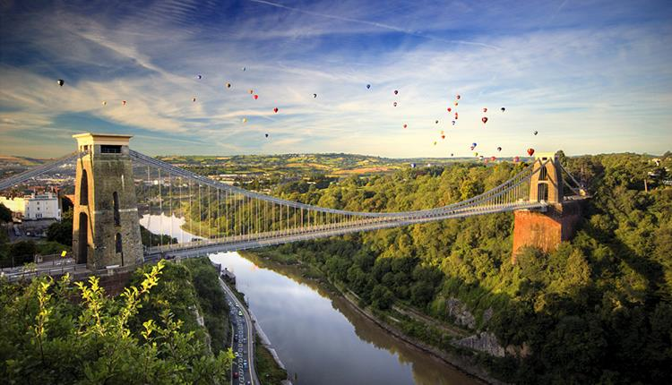
DeepMIP 2018
Bristol
www.deepmip.org
Dan Lunt
DeepMIP overview
Aims of meeting
Agenda
Experimental Design
DeepMIP and IPCC

Slide 2
DeepMIP – The Deep-Time Model Intercomparison Project – www.deepmip.org
DeepMIP is dedicated to conceiving, designing, carrying out, analysing, and disseminating, an international effort to improve our understanding of Deep Time climates.
Objectives of the DeepMIP group:
To foster closer links between the palaeoclimate modelling and data communities.
To design experiments for the MIP, through discussion with both model and data communities.
To carry out such simulations with a wide range of state-of-the-art models.
To create and collate and synthesise datasets where appropriate to enable meaningful model-data comparisons.
To analyse the results with the aims of evaluating the models, understanding the reasons behind the model-model and model-data differences, and, where possible, providing suggestions for model improvements.
To carry out the above in such a way as to facilitate contribution to the IPCC.

Slide 3
Aims of meeting
To further build our model-data community.
To present new modelling and proxy results.
To present updates on progress of the new DeepMIP model results, and learn from other groups.
To finalise the proxy DeepMIP paper.
To plan modelling papers, proxy papers, and model-data comparison papers, and who will write them.

Slide 4
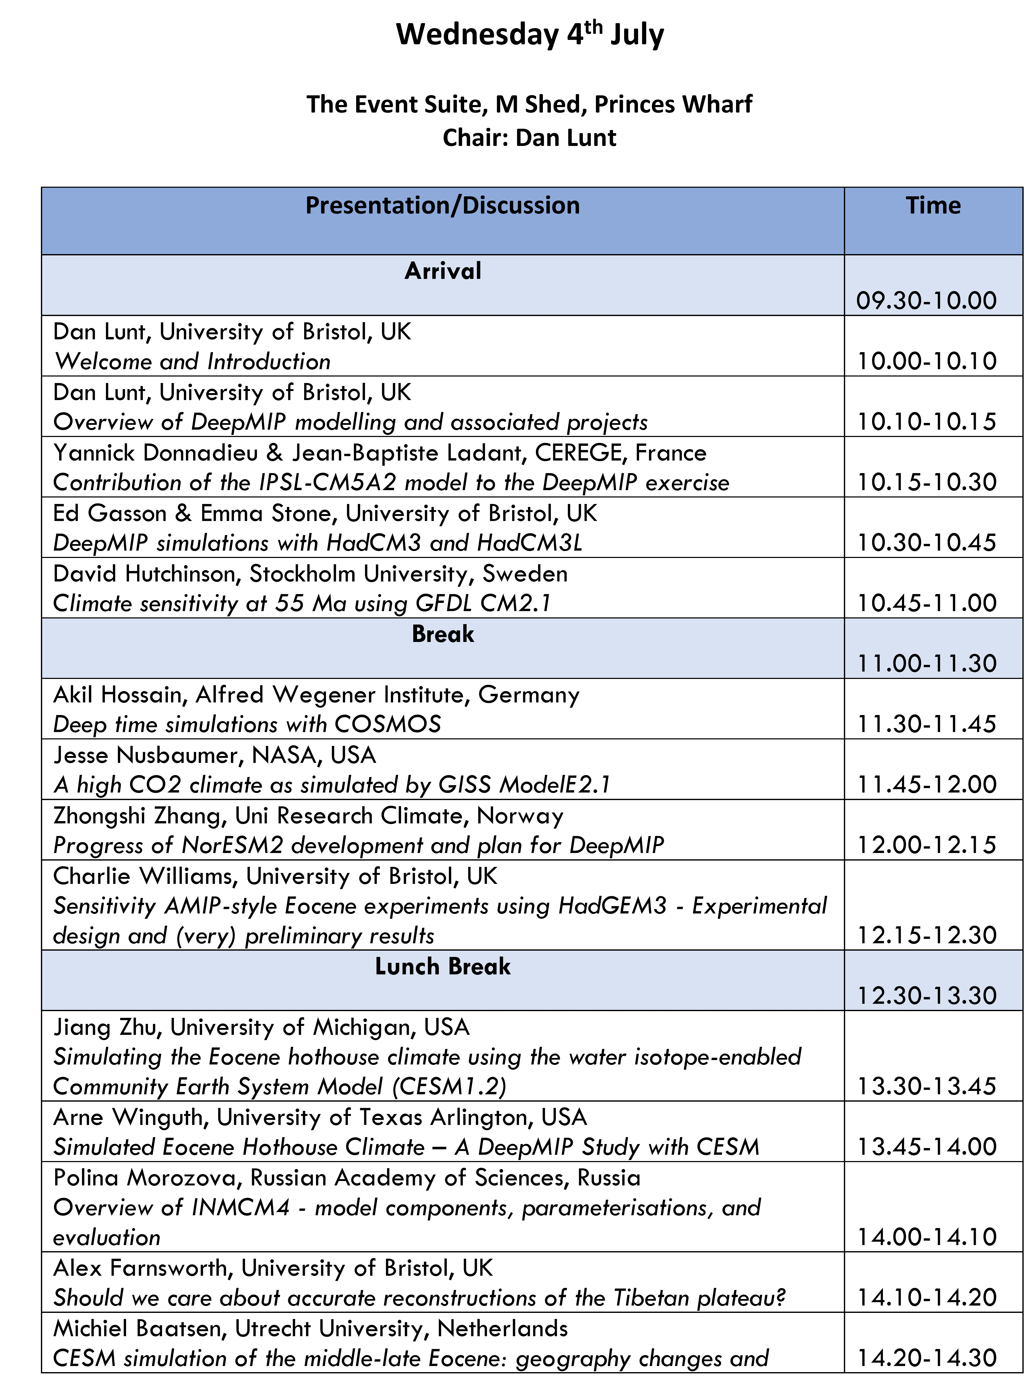
Agenda
Monday:
10am – 2pm: DeepMIP model talks
2pm-2:50pm: Other model talks
3pm-5pm: Discussion of model papers
Tuesday:
9am:2:30pm: Proxy talks
2:30pm-3:30pm: Discussion of proxy papers
4-5pm: Breakouts
Wednesday:
9am-10:10am: Forcing talks
10:40-12:10: Breakouts
1:30-4pm: Collaboration time.

Slide 5
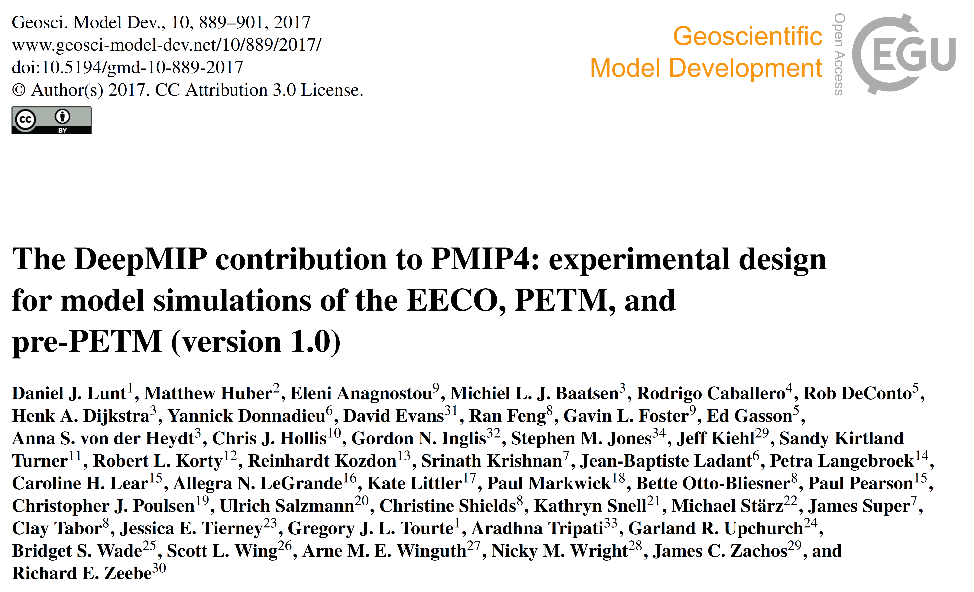
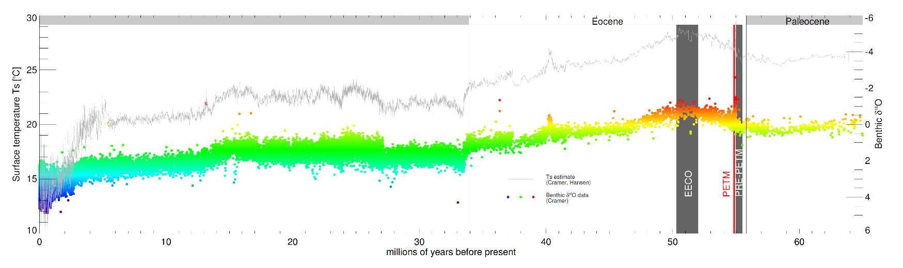
Experimental Design:

Slide 6
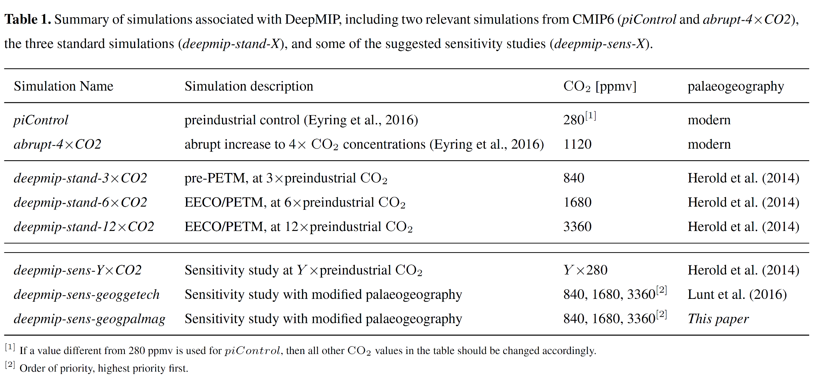
Experimental Design:

Slide 7
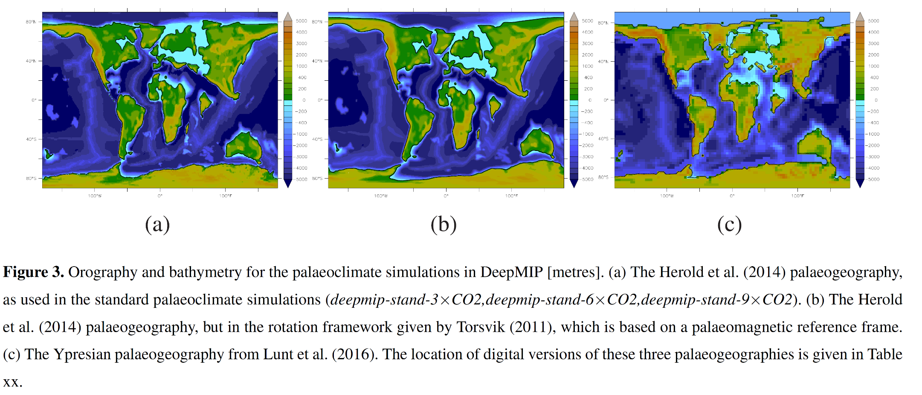
Experimental Design:

Slide 8
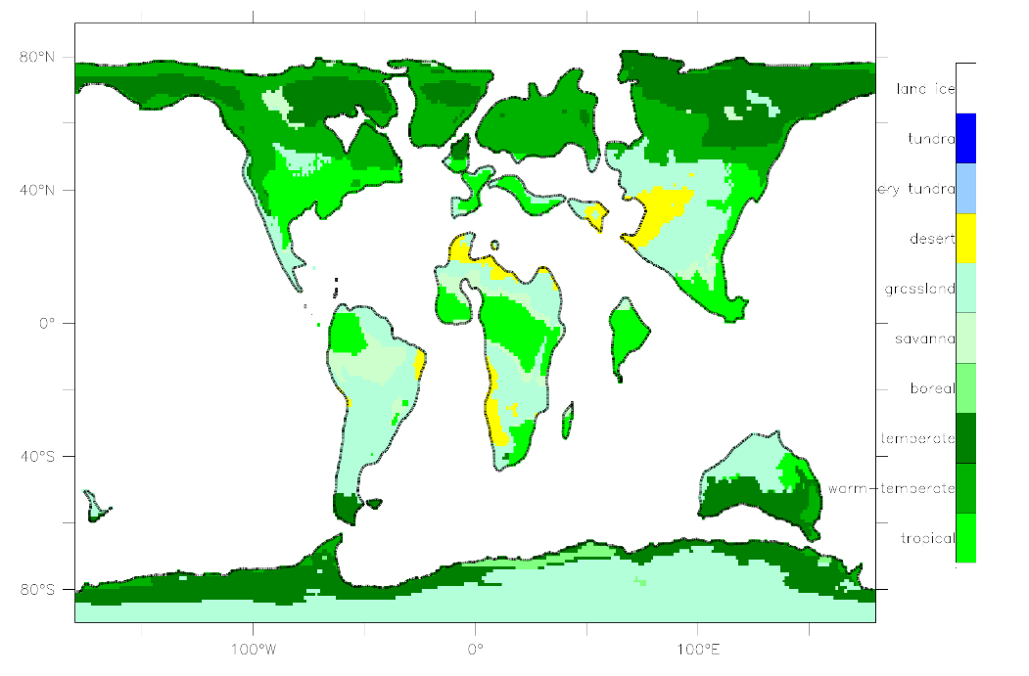
Experimental Design:
Vegetation:
Solar constant = modern
CH₄ = modern
Aerosols = model-specific
Sensitivity studies to all boundary conditions strongly encouraged

Slide 9
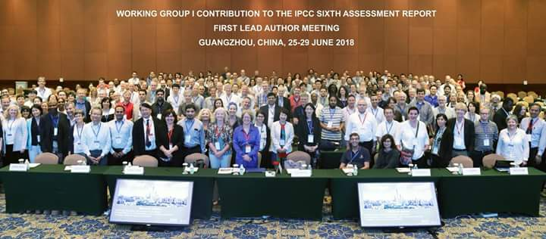
DeepMIP and IPCC
Deadline for Submission of papers: December 2019
Deadline for Acceptance of papers: September 2020

Slide 10
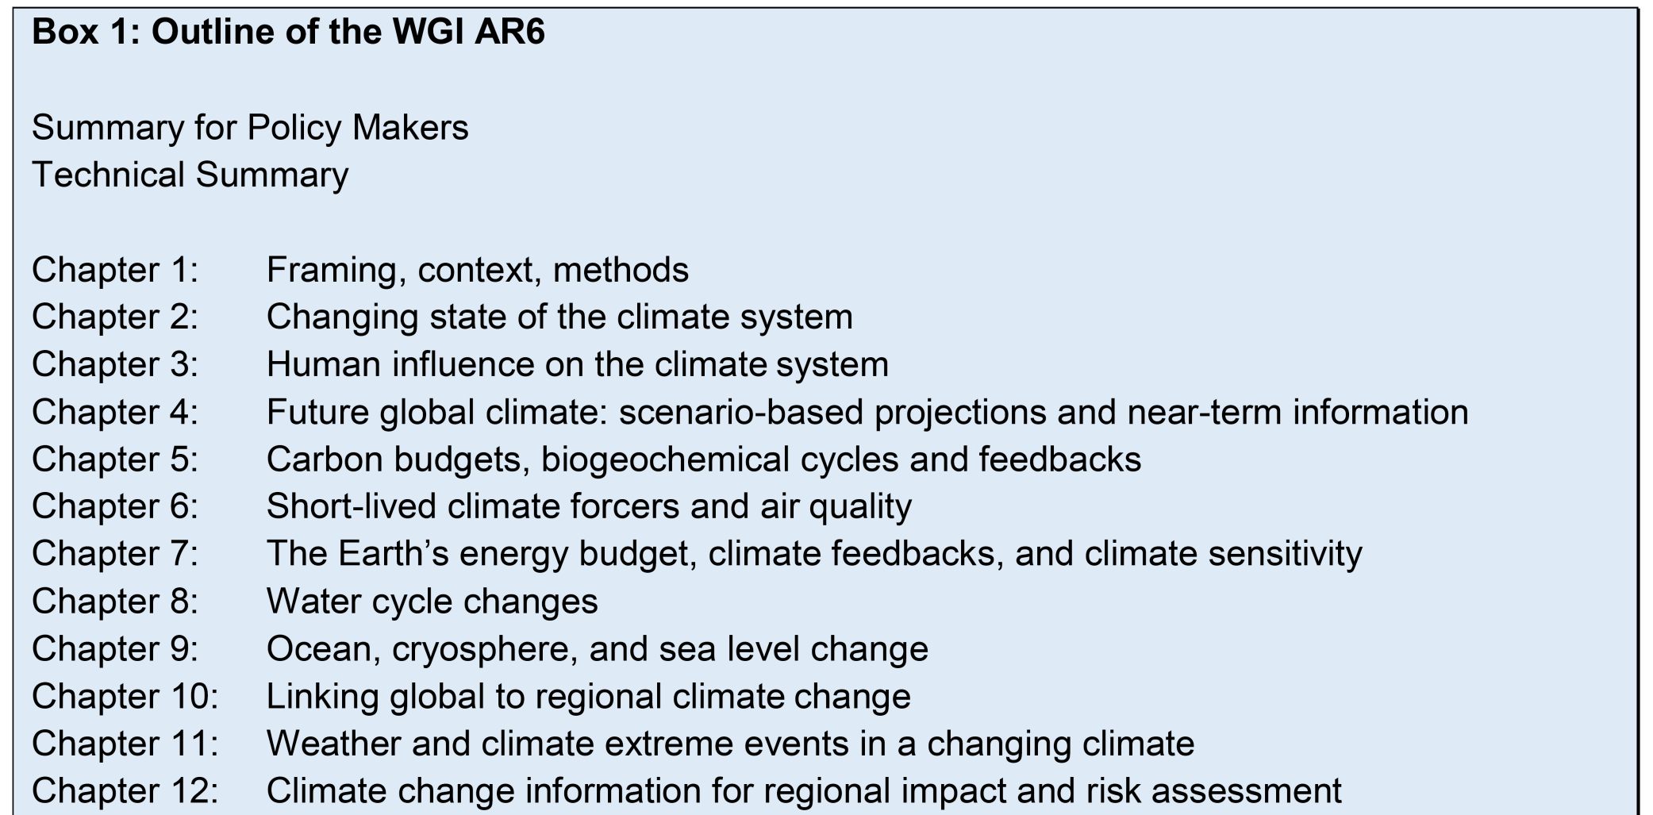
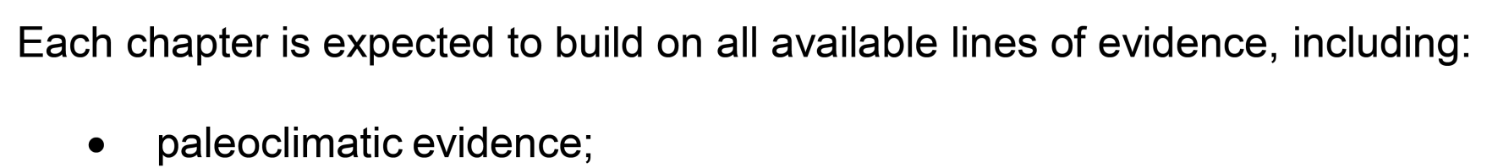
DeepMIP and IPCC

Slide 11
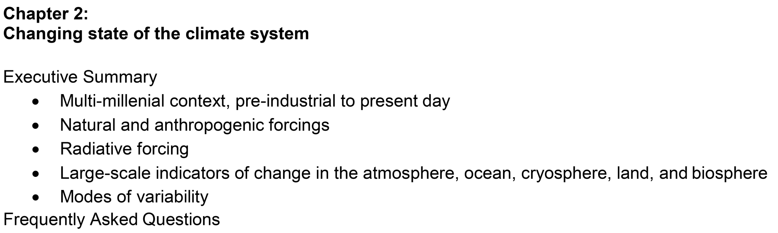
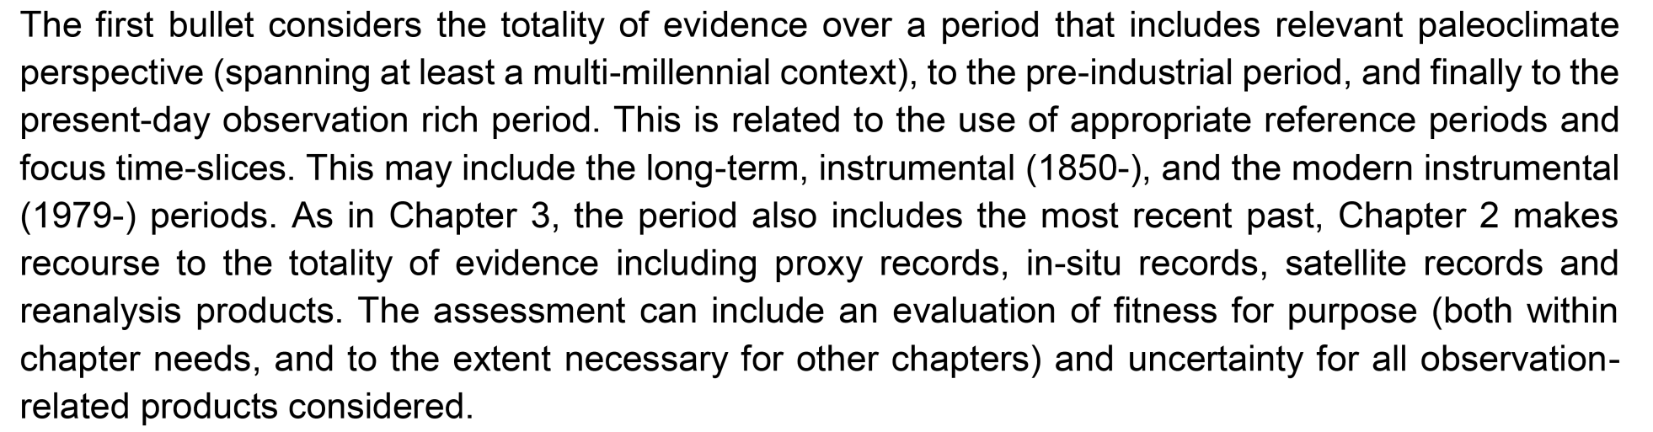
DeepMIP and IPCC
Darrell Kaufman

Slide 12
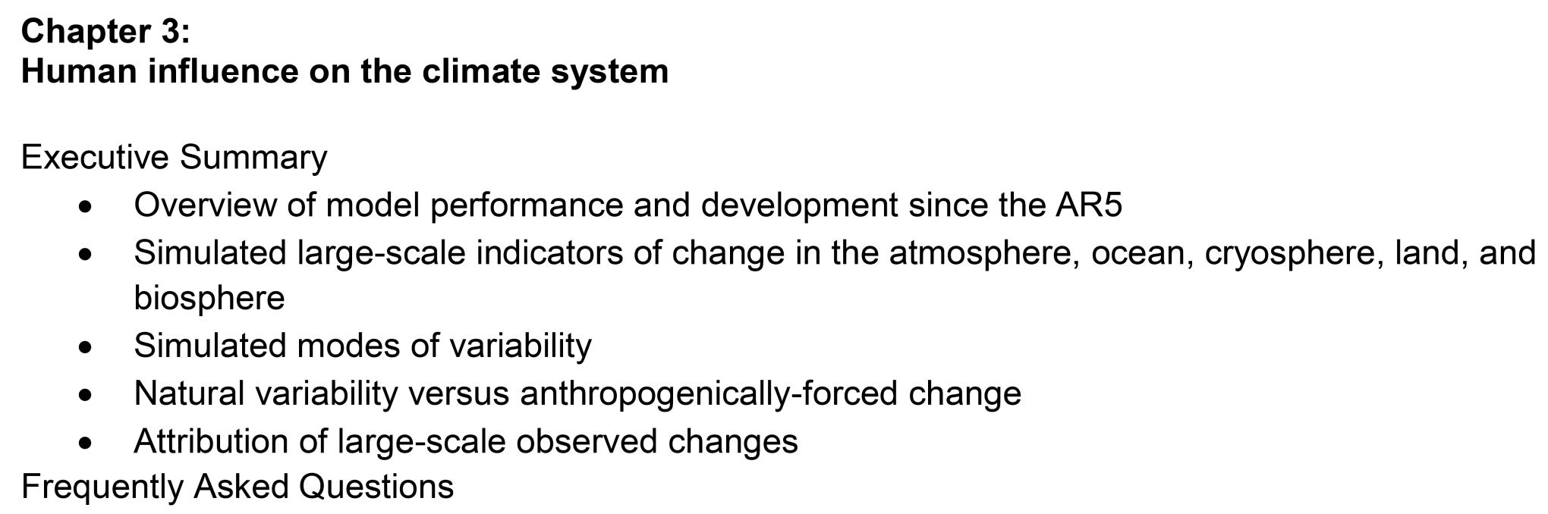
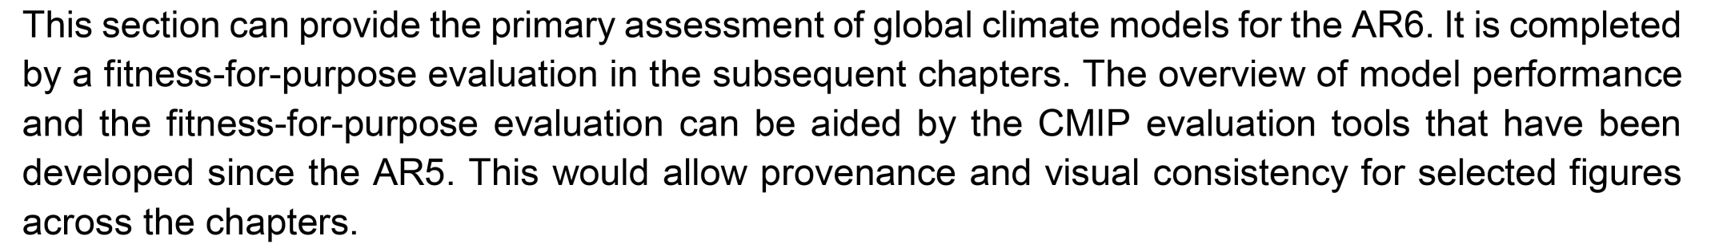
DeepMIP and IPCC
Shayne McGregor

Slide 13
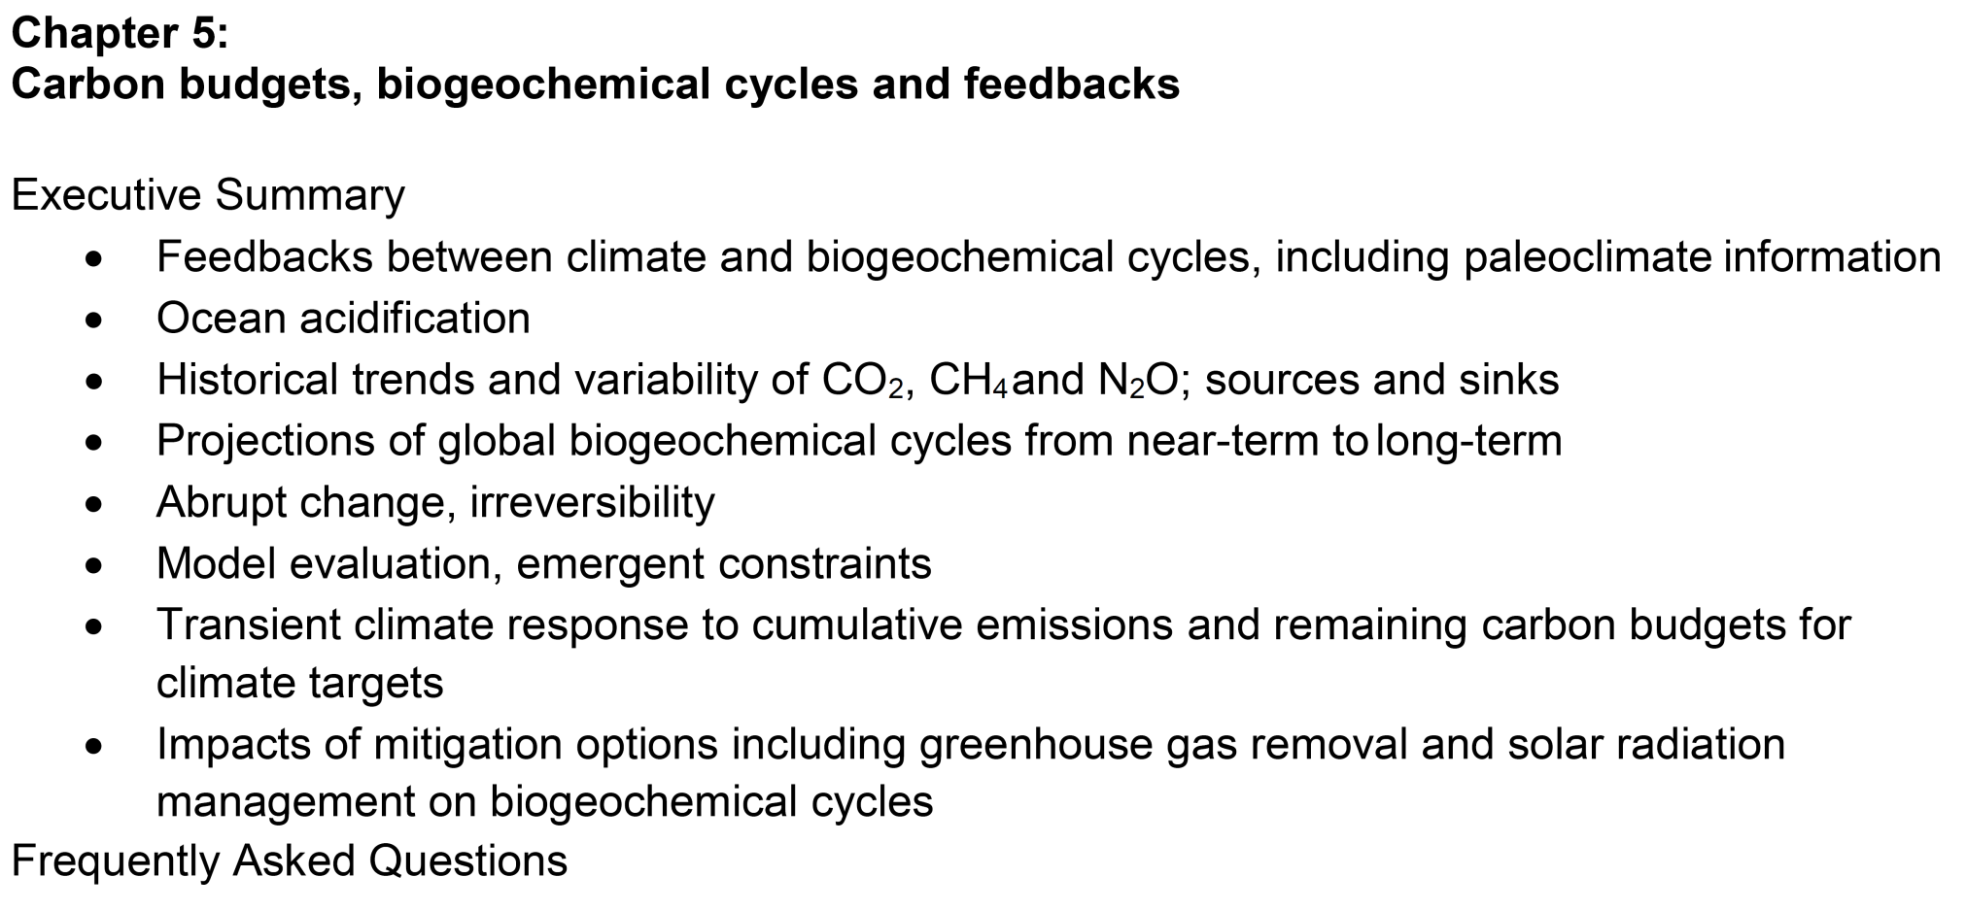
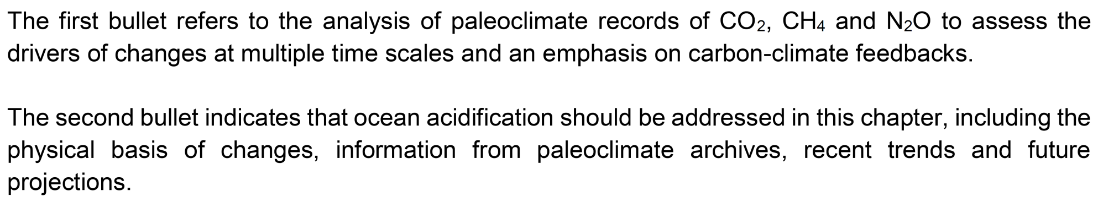
DeepMIP and IPCC
Sam Jaccard

Slide 14
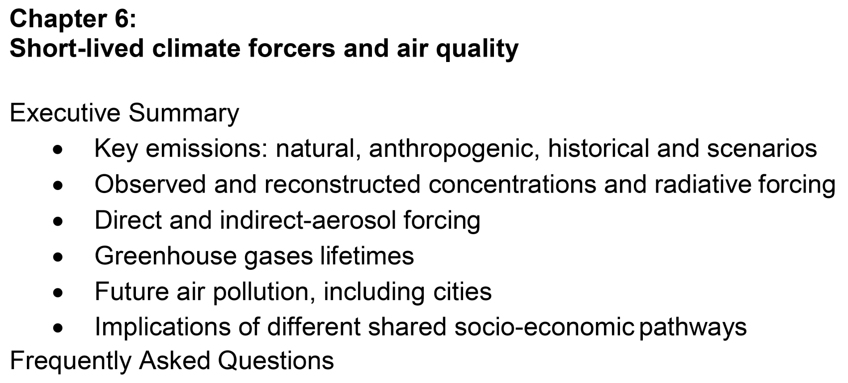
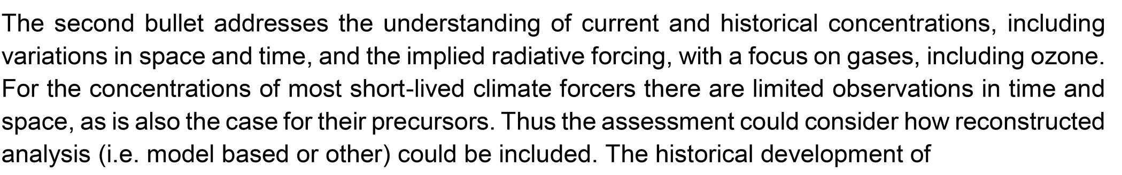
DeepMIP and IPCC
Nadine Unger

Slide 15
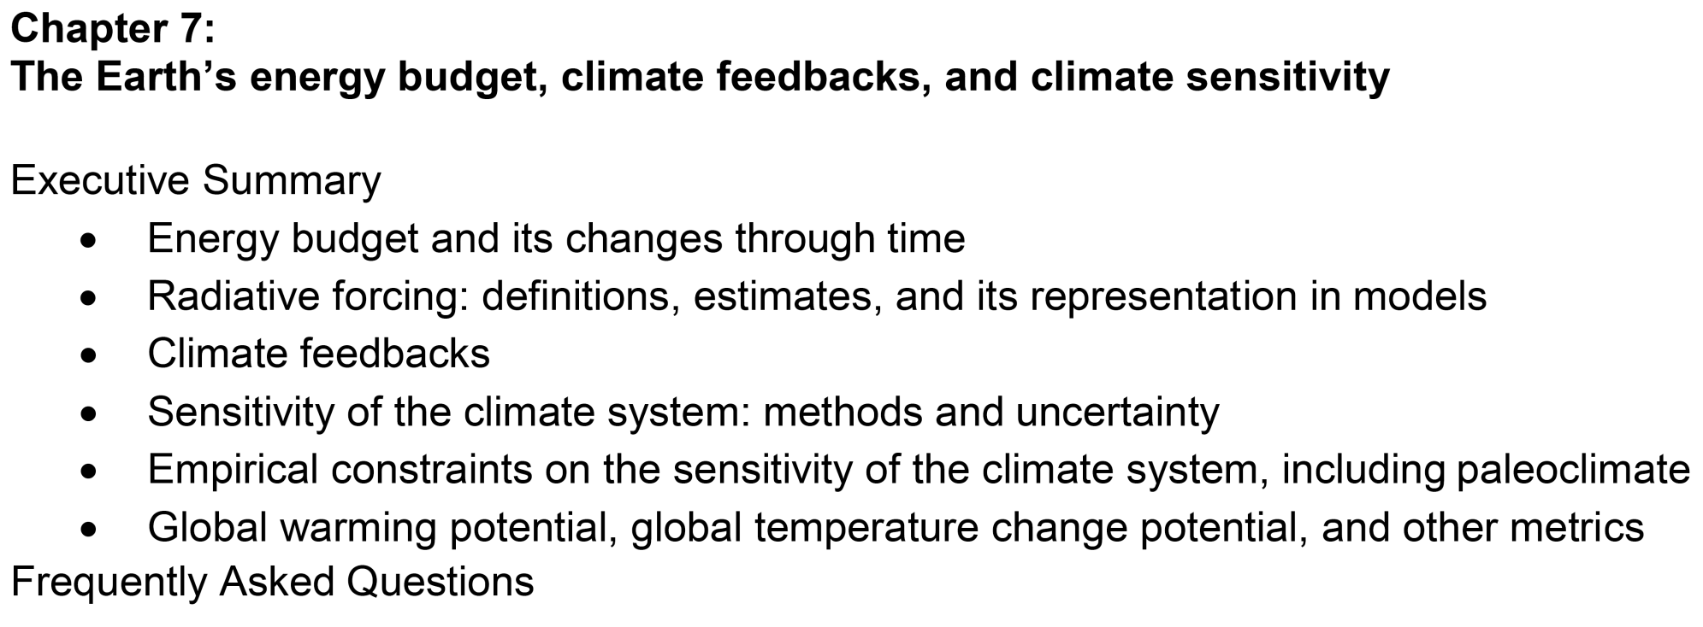
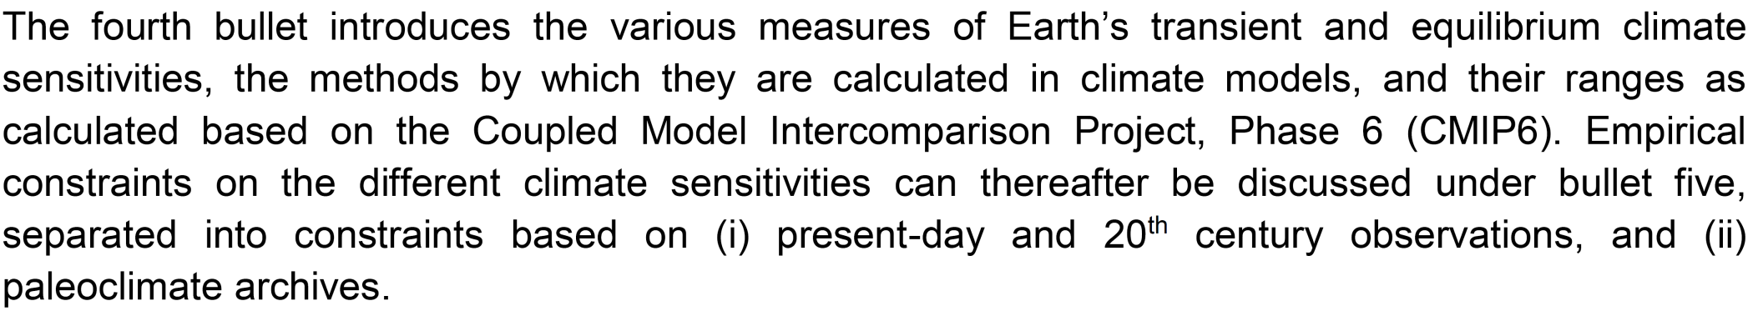
DeepMIP and IPCC
Dan Lunt

Slide 16
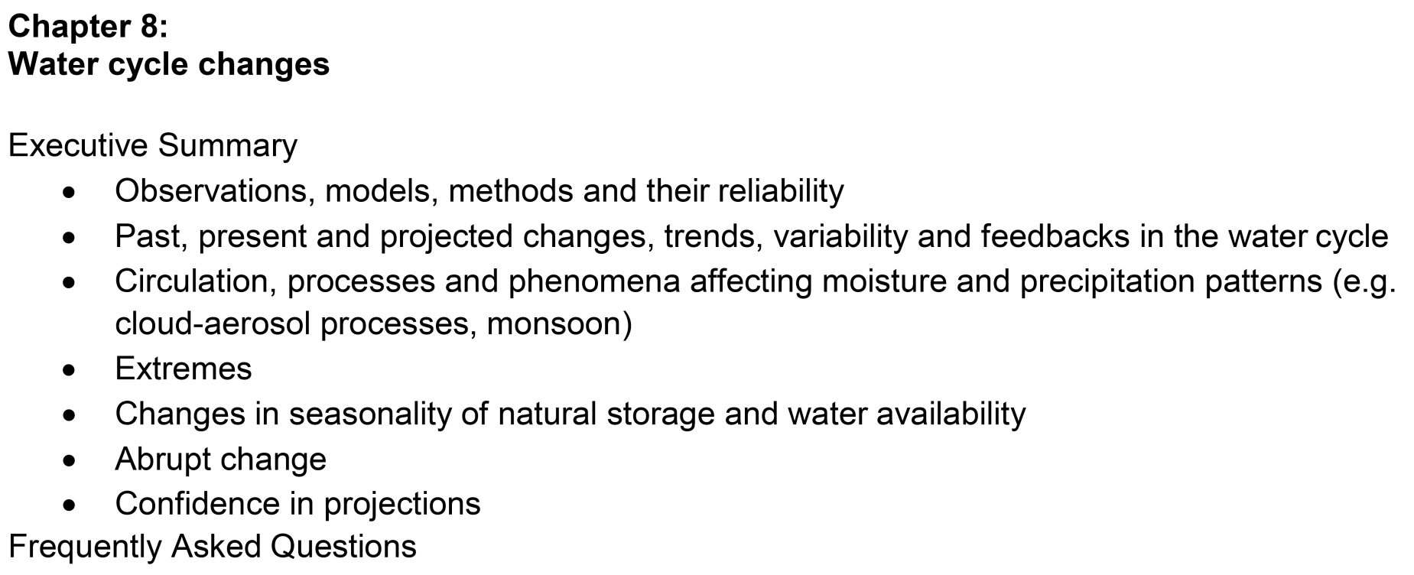
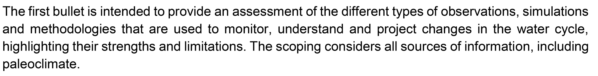
DeepMIP and IPCC
Jess Tierney

Slide 17
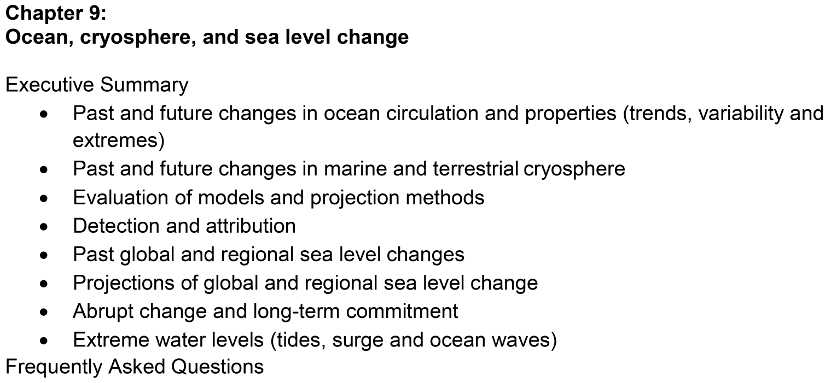
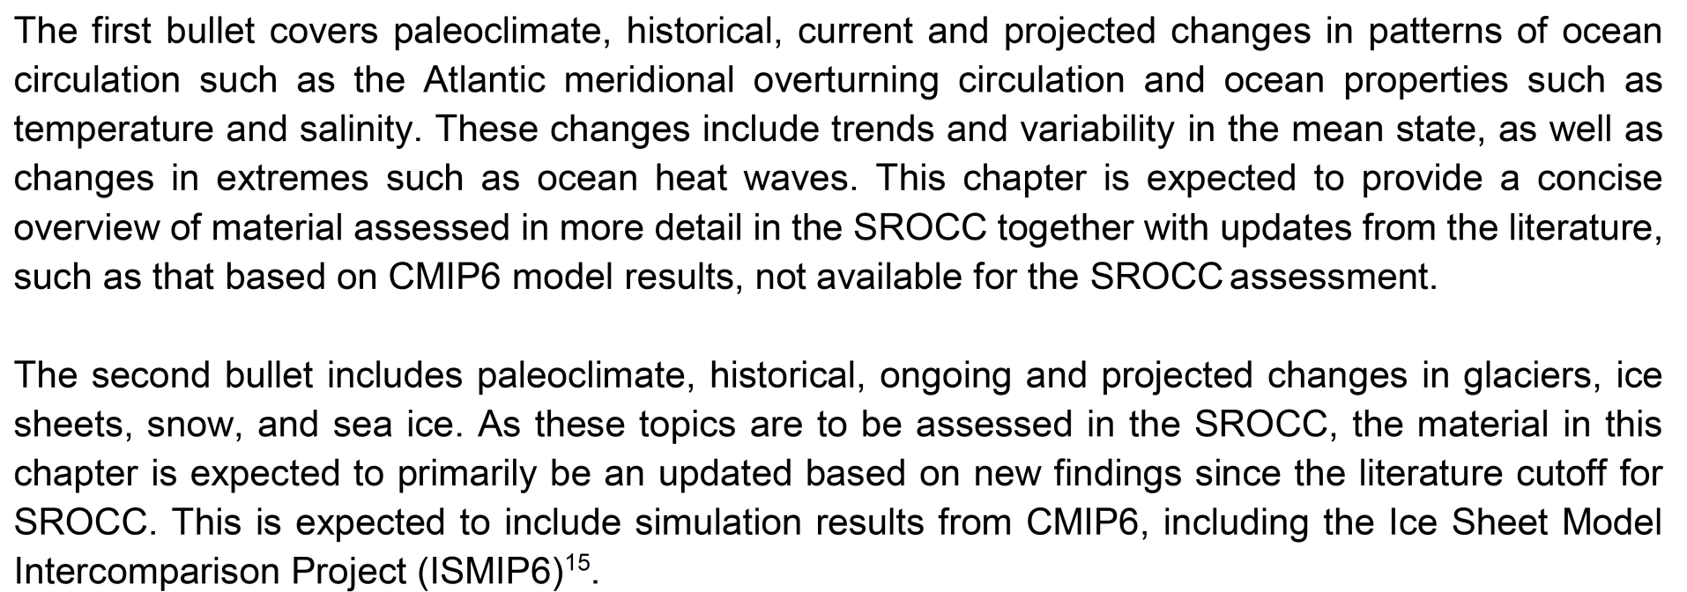
DeepMIP and IPCC
Alan Mix
Nick Golledge

Slide 18
Agenda
Monday:
10am – 2pm: DeepMIP model talks
2pm-2:50pm: Other model talks
3pm-5pm: Discussion of model papers
Tuesday:
9am:2:30pm: Proxy talks
2:30pm-3:30pm: Discussion of proxy papers
4-5pm: Breakouts
Wednesday:
9am-10:10am: Forcing talks
10:40-12:10: Breakouts
1:30-4pm: Collaboration time.

