Slide 1
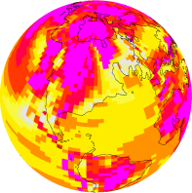
DeepMIP – Deep-time Model Intercomparison Project
www.deepmip.org
Dan Lunt
What is DeepMIP
How did we get here?
Model experimental design (Lunt et al, 2017)
Proxies and Proxy database (Hollis et al, 2019)
Where are we now?
Agenda and Aims of meeting

Slide 2
What is DeepMIP?
www.deepmip.org
DeepMIP is dedicated to conceiving, designing, carrying out, analysing, and disseminating, an international effort to improve our understanding of Deep Time climates.
To foster closer links between the palaeoclimate modelling and data communities.
To design experiments for the MIP, through discussion with both model and data communities.
To carry out such simulations with a wide range of state-of-the-art models.
To create and collate and synthesise datasets where appropriate to enable meaningful model-data comparisons.
To analyse the results with the aims of evaluating the models, understanding the reasons behind the model-model and model-data differences, and, where possible, providing suggestions for model improvements.
To carry out the above in such a way as to facilitate contribution to the IPCC.
DeepMIP is part of the Paleoclimate Modelling Intercomparison Project (PMIP), which itself is affiliated to CMIP6.

Slide 3
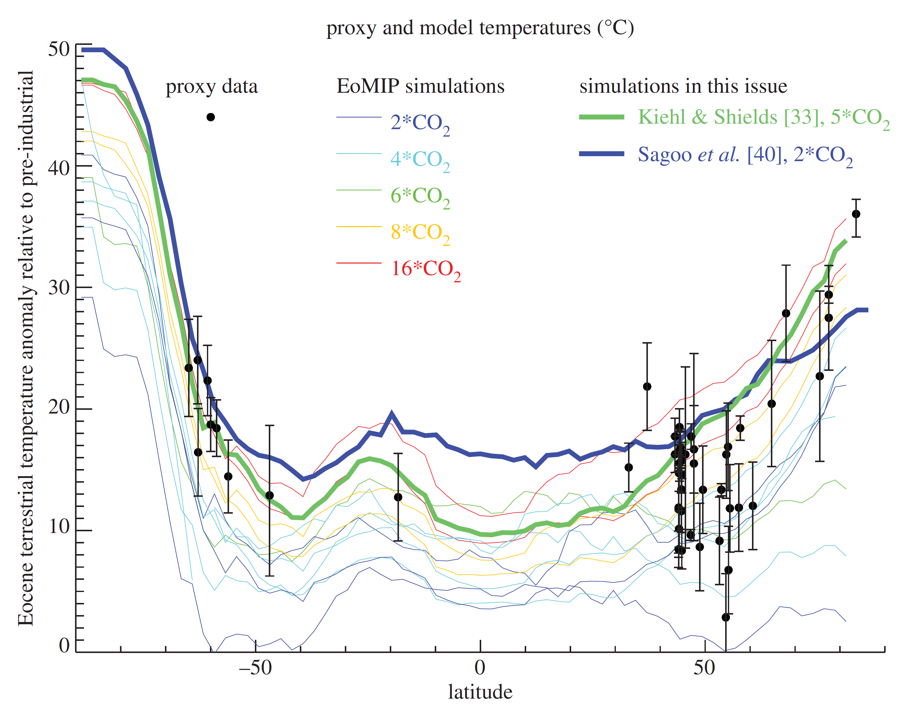
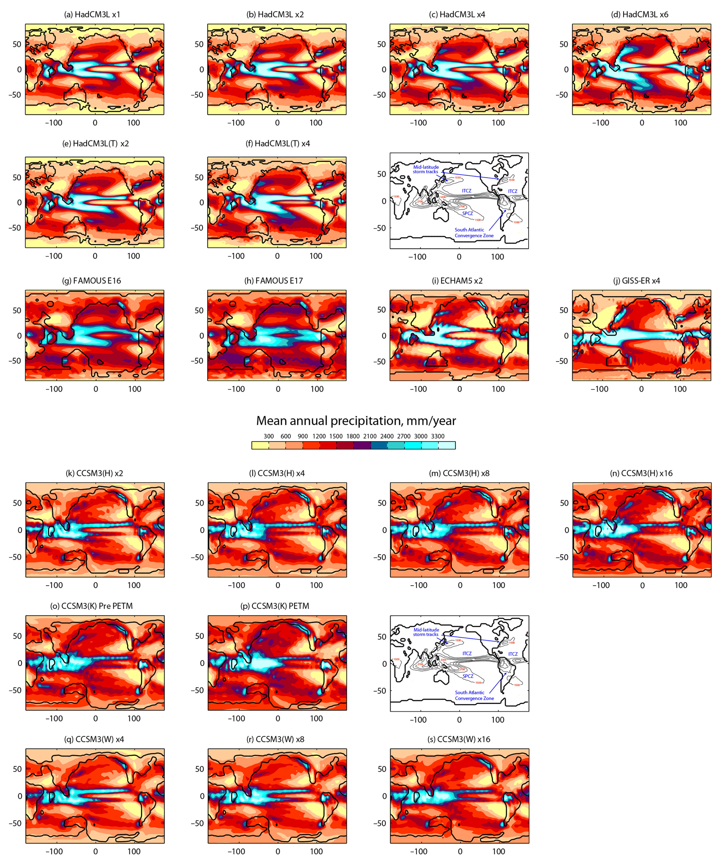
How did we get here?
Kiehl and Shields, 2013
Sagoo et al, 2013
Lunt et al, 2012
Changing model parameters can improve simulations
Some models perform well, but at very high CO₂
Carmichael et al, 2016
Gasson et al, 2014
Best models for temperature are also best models for precipitation
CO₂ threshold for Antarctic glaciation is model-dependent

Slide 4
Model experimental design
Focus on EECO, PETM, and Latest Paleocene
Topography and vegetation boundary conditions from Herold et al (2014)
Multiple CO₂ concentrations
Lunt et al, 2017

Slide 5
Proxies and Proxy database
Temperature: theoretical background, strengths, weaknesses, and recommended methodologies, for d18O, Mg/Ca, clumped isotopes, marine and terrestrial GDGTs, Leaf morphology, NLR.
CO₂: Boron, carbon isotopes, stomata, carbonates
Formal definition of intervals
Presentation of version 0.1 of the DeepMIP proxy database
Hollis et al, 2019

Slide 6
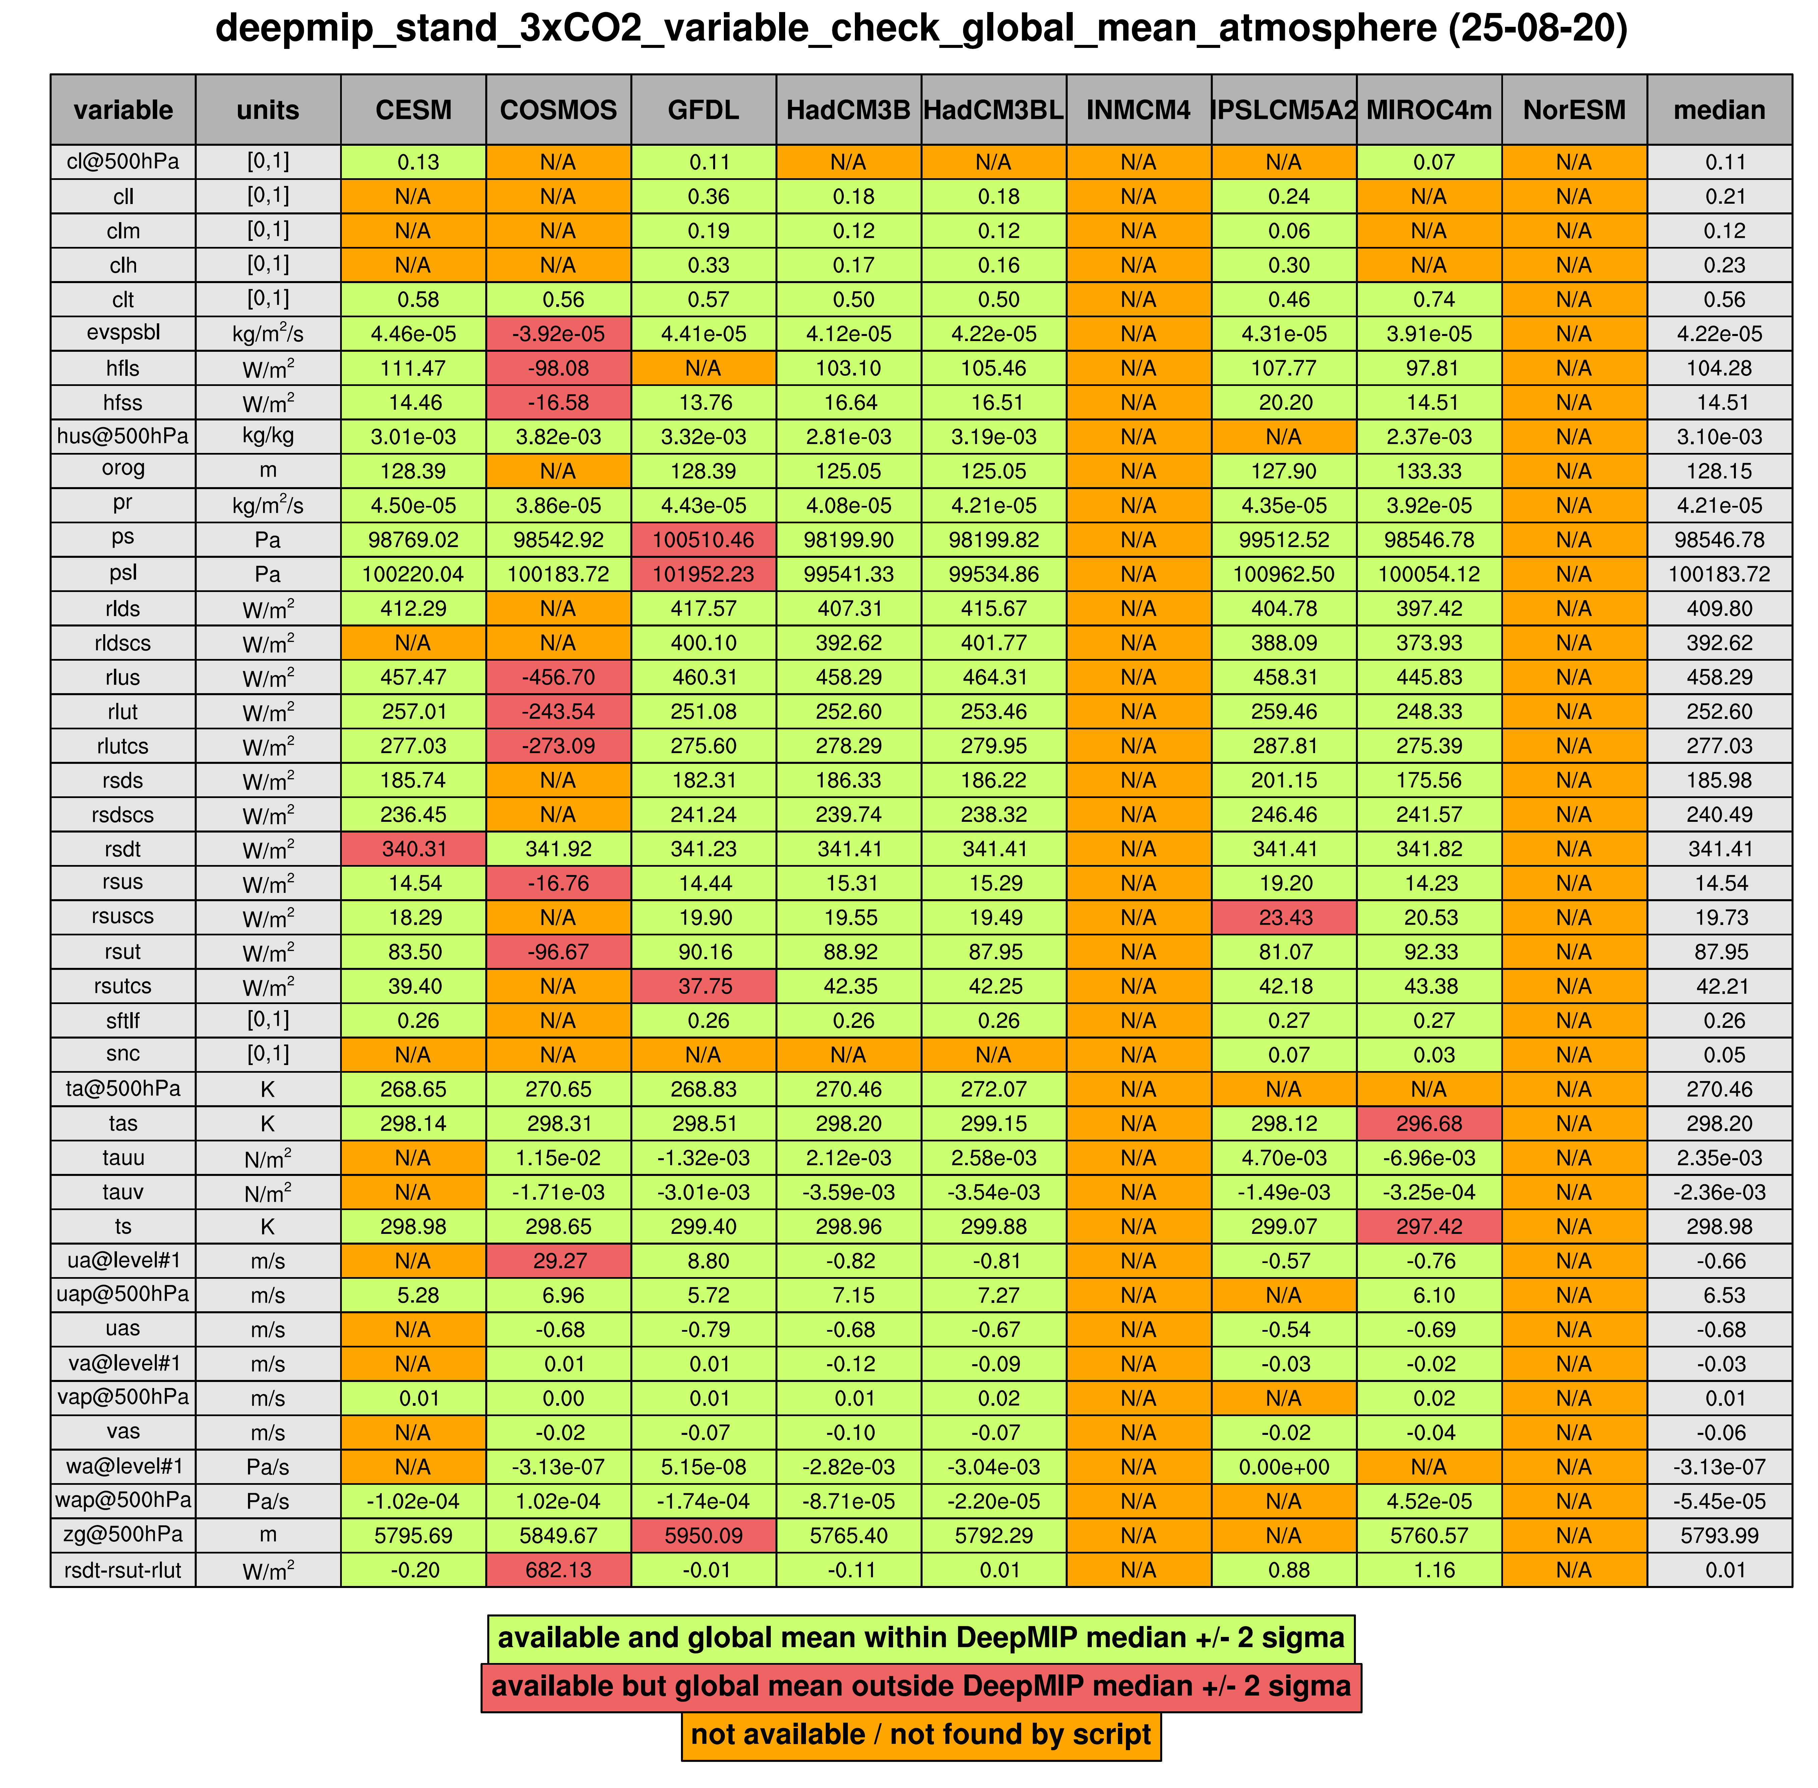
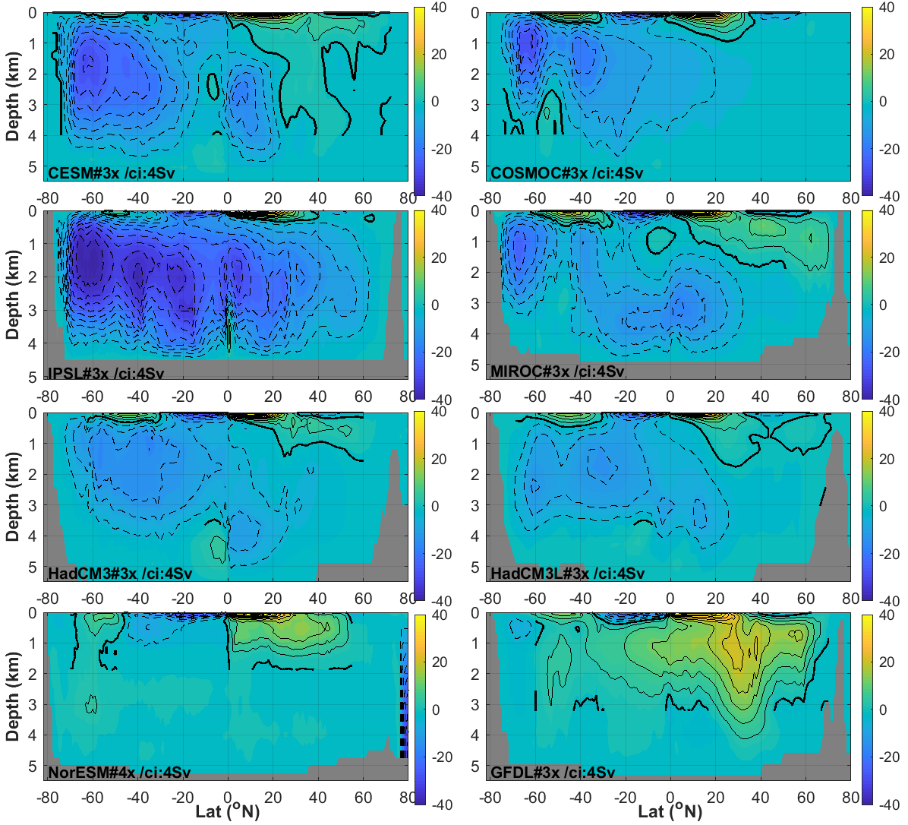

Where are we now?
Proxy-bases estimates of EECO, PETM, and LP global mean temperature and ECS (Inglis et al, submitted)
8 modelling groups have carried out and submitted simulations to the DeepMIP database
Large-scale features and model-data comparison carried out (Lunt et al, submitted)
Strong contribution to IPCC through estimates of global mean temperature (Chapter 2, TS), model-data comparison (Chapter 7), and ECS (Chapter 7, Chapter 4).
Several groups carrying out additional analysis: Ocean circulation, Precipitation, Antarctic climate, Westerlies, Clouds, Monsoons, Seaice

Slide 7
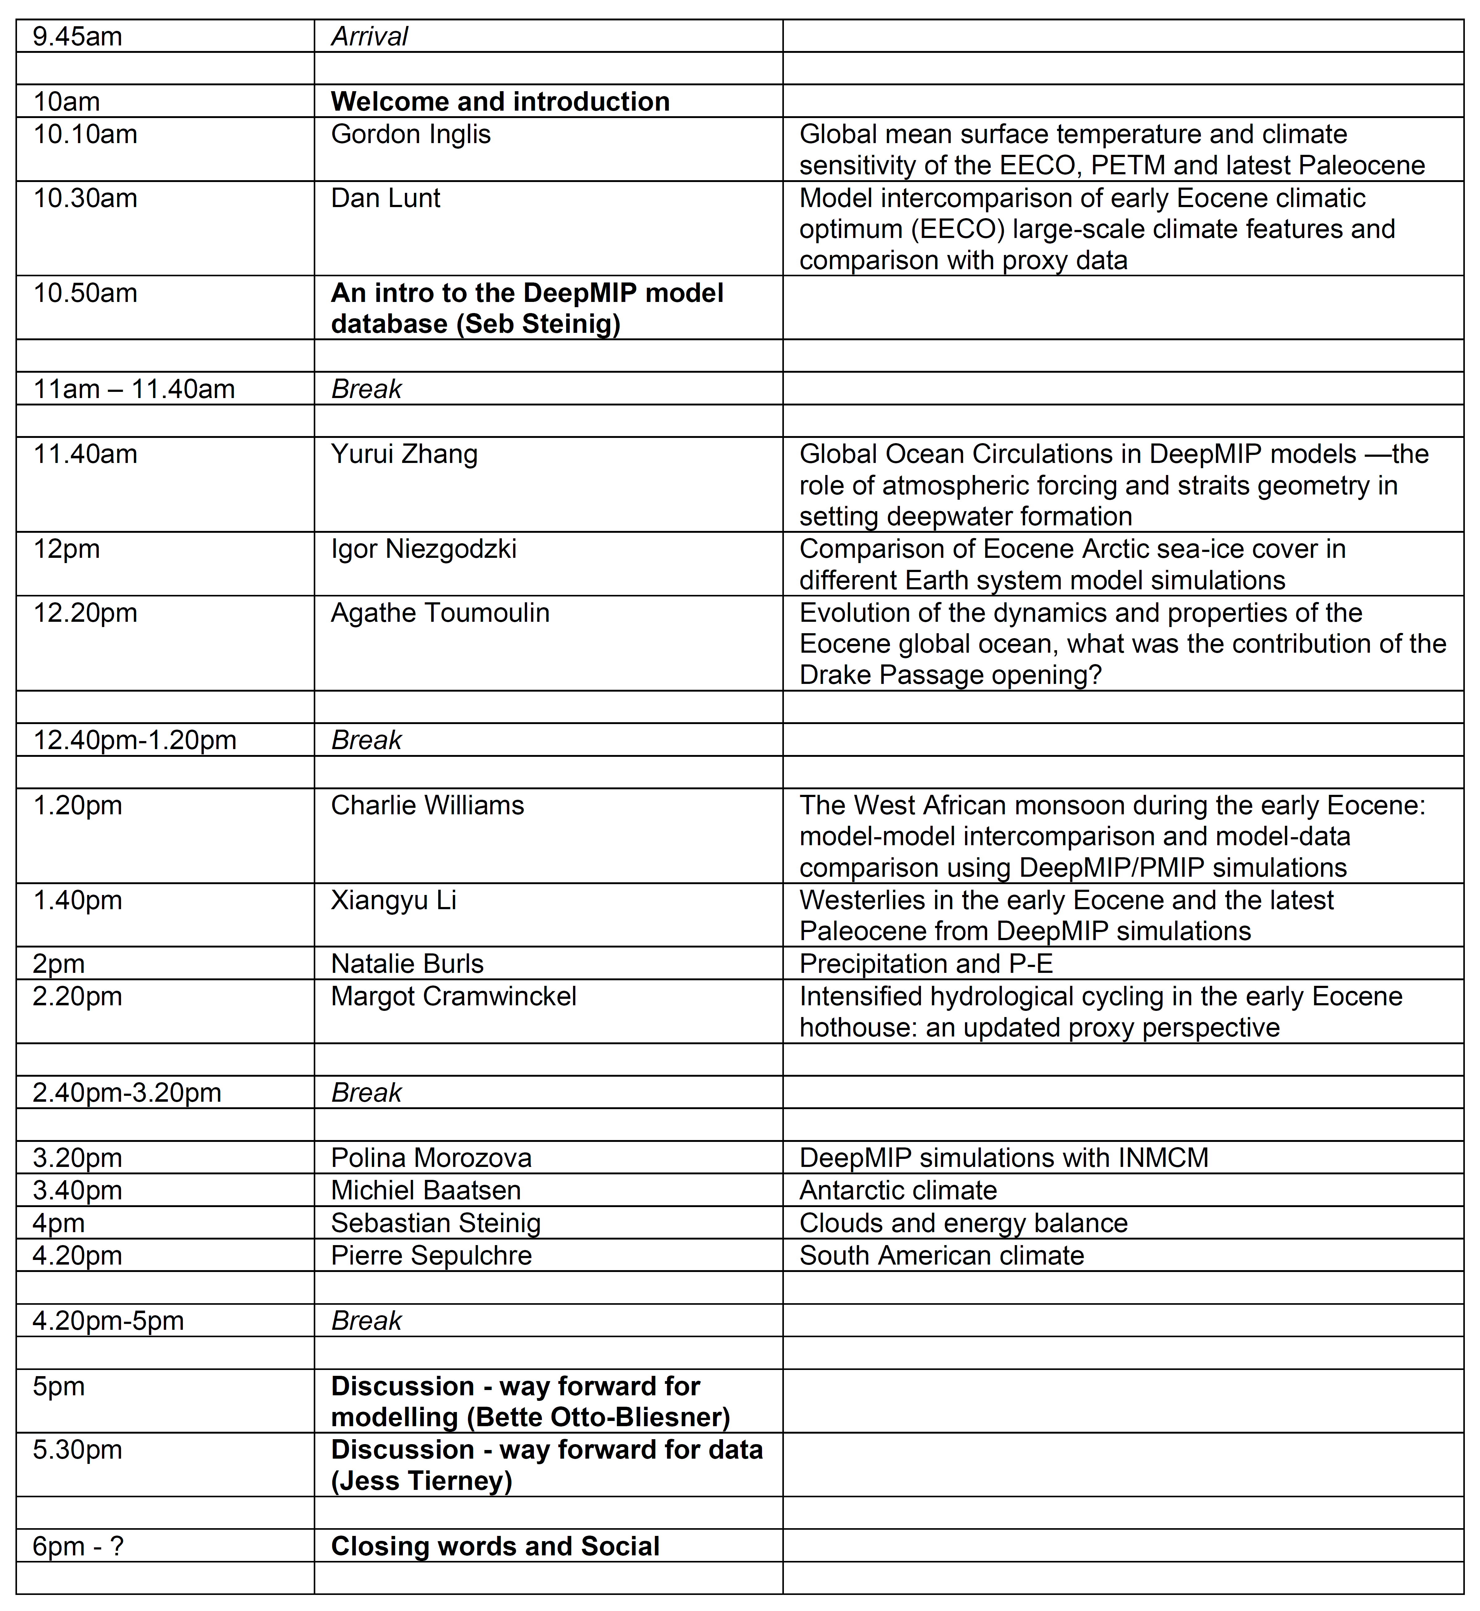
Agenda and Aims of meeting
Mute
Use chat function
Breaks
Social
To hear about exciting new science!
To support those already committed to writing papers on the model simulation (e.g. linking together data people and modellers).
Finding opportunities for other new science, associated with modelling and/or proxy databases.
Huge thanks to all modelling groups and those carrying out analyses !!

